Slide 1





Investigating the Use of IoT for Smart Waste Management
CSCI 6991 Data Engineering Capstone
Suryakanth Gunnam
Praneeth Reddy
Kranthi Kumar

Slide 2

Introduction
Waste disposal and management has become an area of concern due to urbanization which enhances the production of waste thus overwhelming the traditional systems in waste disposal.
Traditional approaches lead to losses, contamination of the environment and the spread of diseases (Ahmed et al ., 2023).
IoT introduces better efficiency of waste disposal, sorting and management (Dubey et al., 2020).
This paper discusses IoT applications and issues in implementing smart waste management solutions.

Slide 3





Background
Dynamic routing also prevents unprovoked collection trips as elaborated by Brous et al., 2020).
Reduces wasting time and resources in managing the busy city’s waste, and helps to achieve the goals of smart city successfully.
IoT is the way of linking devices for their immediate data processing and interaction.
Waste IoT places sensors on bins, vehicles, and buildings (Belli et al., 2020).

Slide 4
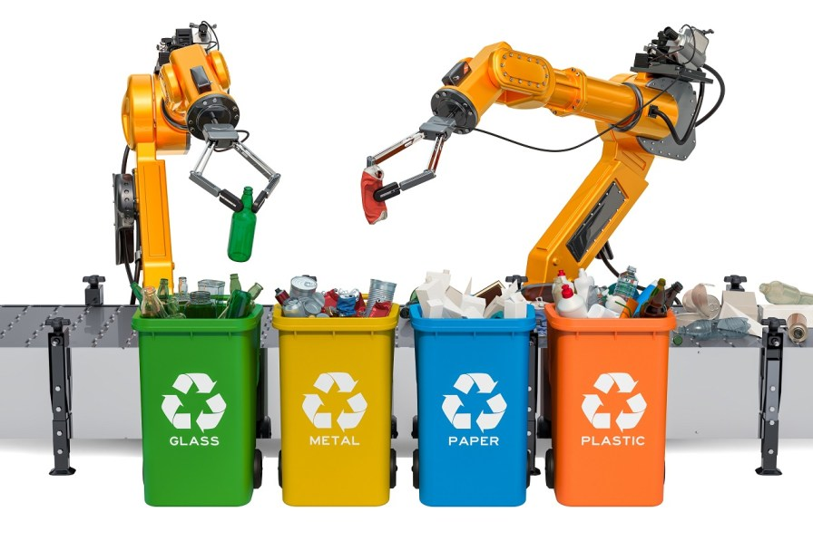
IoT Applications in Waste Management
Load sensors are installed on smart bins triggering collection agencies (as cited in Dubey et al., 2020).
Mechanical systems sort wastes those that may be recycled those that are hazardous, and organic wastes (Ahmed et al., 2023).
The gas sensors keep track of toxic fumes so that corrections may be made before problems arise (Sanger et al., 2021).
Real-time tracking avails real-time effectiveness and augmented light on performance appraisal.

Slide 5




Challenges to implementing IoT
Challenges include cost of the sensors, cost of communication systems infrastructure and other requisite components (Abdullah Addas et al., p 242).
Some of the technical problems are non-functioning sensors and incorrect data (Rahman et al., 2023).
Perceived publicly control, boycott because people are concerned about data being collected (Hussain et al., 2024).
Internet connection is still a constraint in some areas hence impacts on system size.

Slide 6


Current Use Cases
India: Pedestal bins with Wi-Fi enable responsible disposal in twin-bin systems (Saha & Chaki, 2023).
Ghana: Containerized solar powered compaction technology decreases collection frequency (Syed et al., 2021).
Examples quoted highlight issues of scalability but show that feasibility is a possibility.
Illustrates how IoT can be used to increase engagement and encourage sustainable practices within communities.

Slide 7
Research Objectives
Investigate the application of IoT technology and its impacts on efficiency and sustainability.
Describe various types of barriers to IoT at the economic, technical, and social levels.
Suggest measures for lasting incorporation of the IoT as a system in urban areas.
Minimize the knowledge gaps regarding IoT and its effects on the environment and society.

Slide 8









Problem Statement
Statistical results: Fixed collection schedules and non-automated processes exhibit inefficiencies (Siddiqui et al., 2023).
Economic factors limit the usage of IoT in developing areas (Abdullah Addas et al., 2024).
Problems at a technical level include poor accuracy in sensors and the quality of sounds that is poor connectivity (Rahman et al., 2023).
Social challenges like privacy prevent broader user adoption (Hussain et al., 2024).

Slide 9







Methodology
Systematic Literature Review (SLR) is aimed at recognizing patterns and gaps.
Search conducted in databases: Scopus, including the Web of Science, Google Scholar, IEEE Xplore, and Science Direct.
Inclusion criteria: The second source includes scholarly journals mostly in the form of articles from international refereed journals (2014–2024) on IoT in waste management.
Final dataset: 40 articles for thematic analysis, 27 of which met inclusion criteria for quality assessment.

Slide 10




Findings
IoT enhances the methods of waste collection through the use of sensors and tracking devices (Ahmed et al., 2023).
Challenges such as; high initial investment and connection problems (Rahman et al., 2023).
Sustainability gains: emissions have been lowered and recycling improved (Saha & Chaki, 2023).
Integrating AI to predictive analytics enhances the distribution of resources (Fang et al., 2023).

Slide 11




Discussion
IoT enhances organization’s functioning and is relevant to sustainability objectives.
Challenges continue to exist especially in the developing countries where there are likely to be scarce resources.
The use of predictive analytics makes it easy to plan on the needs of waste management in any given region.
There is need for increased sensitization and implementation of better policies to foster the uptake of green energy solutions.

Slide 12

Policy Recommendations
Support the adoption of low-cost IoT platforms as target markets for growth are mostly in the developing world.
Frequency of maintenance on IoT systems need to be embraced so that the systems will be fully reliable.
Implement numerous and clear data regulation measures to capture the privacy issue.
Apply IoT on energy and transportation systems in cities to bring scalability.

Slide 13
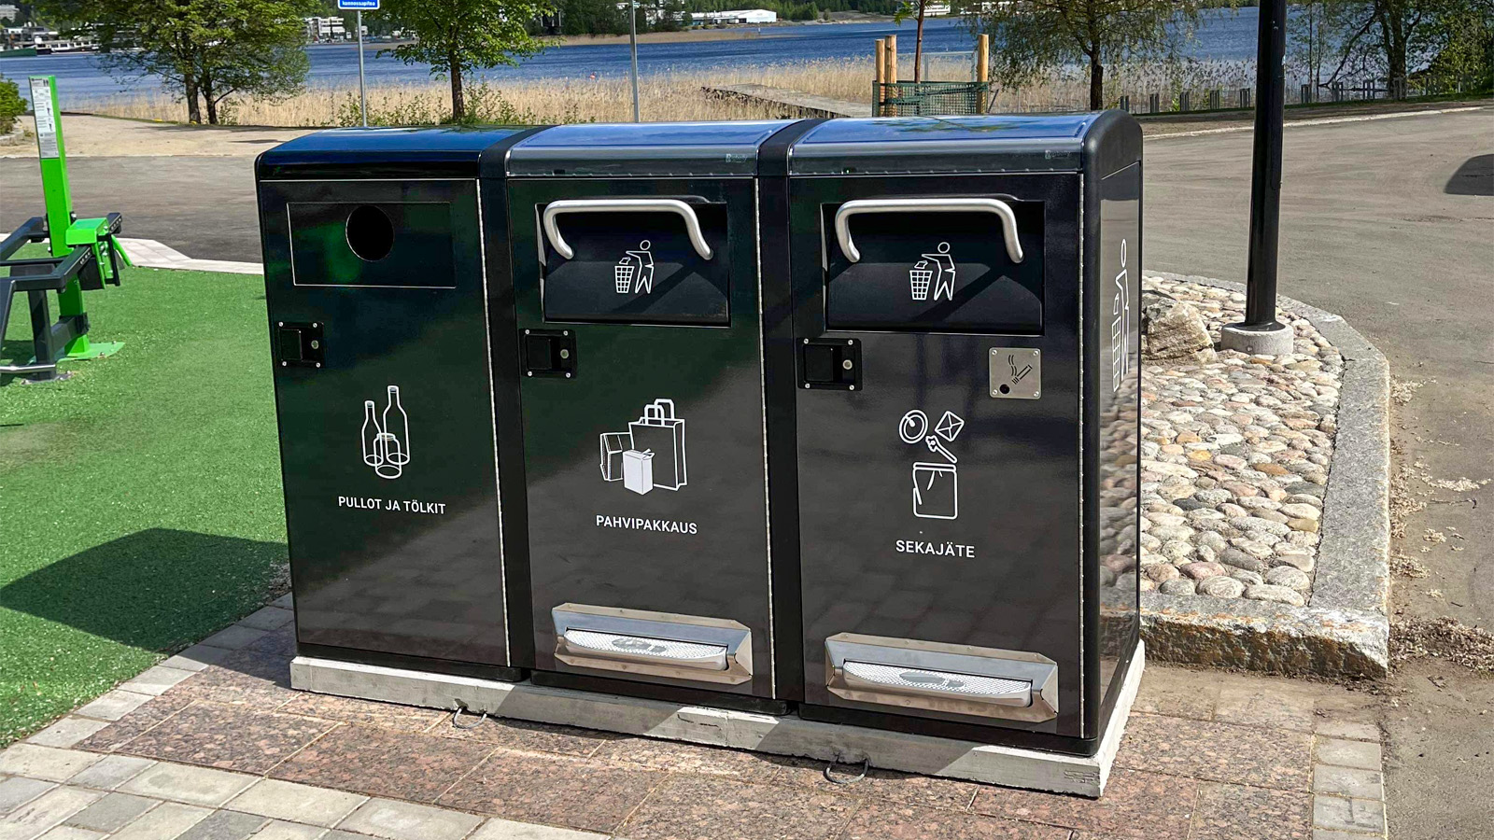
Conclusion
IoT contributes to the enhancement of sustainable waste management practices as it fosters the revolution in that area.
Barriers include the cost accrual, technical factors, and social opposition.
Reducing risks and costs, commitment, and perceived benefits can lead to IoT adoption.
Further research should focus on the long-term consequences and accommodate smart city concepts.

Slide 14
Contribution Of Team Members
Name | Contribution
Suryakanth Gunnam | Introduction, background, and challenges of IoT in waste management.
Kranthi Kumar Gaddam | IoT applications, research objectives, and policy recommendations for waste management.
Praneeth Reddy | Current use cases, problem statement, methodology, findings, and discussion points.

Slide 15
References
Abdullah Addas, K., Khan, M. N., & Naseer, F. (2024). Waste management 2.0 leveraging internet of things for an efficient and eco-friendly smart city solution. PLoS ONE, 19(7), e0307608.
Ahmed, M. M., Ehab Hassanien, & Aboul Ella Hassanien. (2023). IoT-based intelligent waste management system. Neural Computing and Applications, 35(32), 23551–23579.
Belli, L., Cilfone, A., Davoli, L., Ferrari, G., et al. (2020). IoT-Enabled Smart Sustainable Cities: Challenges and Approaches. Smart Cities, 3(3), 1039–1071.
Brous, P., Janssen, M., & Herder, P. (2020). The dual effects of IoT: Benefits and risks for waste management. International Journal of Information Management, 51, 101952.
Dubey, S., Singh, P., Yadav, P., & Singh, K. K. (2020). Household waste management system using IoT and machine learning. Procedia Computer Science, 167, 1950-1959.
Fang, B., Yu, J., Chen, Z., Osman, A. I., et al. (2023). Artificial intelligence for waste management in smart cities. Environmental Chemistry Letters, 21(4), 1959–1989.
Henaien, A., Ben Elhadj, H., & Fourati, L. C. (2024). A sustainable smart IoT-based solid waste management system. Future Generation Computer Systems, 157, 587–602.
Hussain, D. I., Elomri, A., Kerbache, L., et al. (2024). Smart City Solutions: IoT waste management models. Sustainable Cities and Society, 103, 105247.
Rahman, M. S., Ghosh, T., Ferdous Aurna, N., et al. (2023). IoT and machine learning in waste management. Measurement Sensors, 28, 100822.
Saha, S., & Chaki, R. (2023). IoT-based smart waste management system. Journal of Open Innovation Technology, 9(2), 100048.
Sanger, J. B., Sitanayah, L., & Ahmad, I. (2021). A sensor-based garbage gas detection system. IEEE CCWC, 9376147.
Siddiqui, A., Hahladakis, J. N., & Al-Attiya, W. A. K. A. (2023). Challenges of conventional waste management in urban contexts. Environmental Science and Pollution Research, 29, 58514–58536.
Syed, A. S., Sierra-Sosa, D., Kumar, A., & Adel Elmaghraby. (2021). IoT in Smart Cities: Survey of Technologies. Smart Cities, 4(2), 429–475.
Twabi, A., & Mikeka, C. (2021). Challenges of IoT adoption in developing countries. International Conference on Electrical, Computer, and Energy Technologies (ICECET).
Vishnu, S., Ramson, S. R. J., Senith, S., et al. (2021). IoT-enabled solid waste management in smart cities. Smart Cities, 4, 1004–1017.

